Slide 1

Mobile Application System Design
(Chapter 4)
Course Lecturer: Nurul Amera Muhamad Nazmi

Slide 2

Key Concepts: Designing Custom Views
Nested Widgets in Container
ListView
GridView

Slide 3
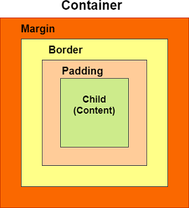
Nested Widgets in Container
Container in flutter is a convenience widget that combines common coloring, positioning, and sizing of widgets.
A Container widget can be used to store one or more widgets and position them on the screen according to our convenience.
Basically, a container is like a box to store contents.
Mobile Application System Design

Slide 4
CLASS ACTIVITY
(1st Hands-On Practice)

Slide 5
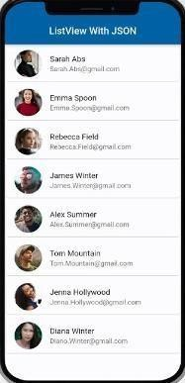
ListView
Flutter ListView is the most commonly used scrolling widget.
It displays its children one after another in the scroll direction.
Mobile Application System Design

Slide 6
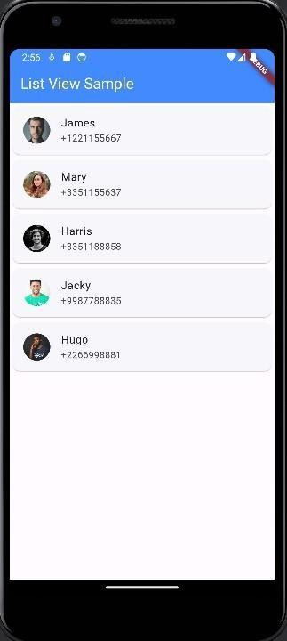
Example App (Contact List)
In this Contact List app, we are going to build a simple contact list using ListView.
Create a new Flutter project.
Create a new folder and subfolder named “assets” and “images”
Copy and paste the given people-1.jpg, people-2.jpg, …, people-5.jpg to the images folder.
Set the pubspec.yaml file for image path.
Mobile Application System Design

Slide 7
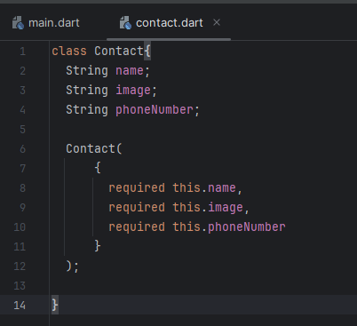
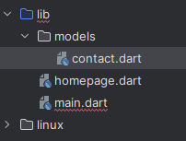
Example App (Contact List)
Create a new subfolder named “models” inside the lib folder.
Create a new dart file named “contact.dart” in the
“models’ subfolder.
Create a Contact data class in the file.
Mobile Application System Design

Slide 8
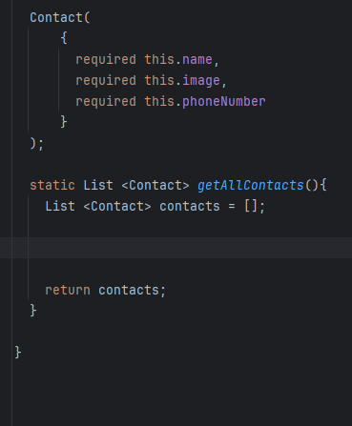
Example App (Contact List)
In Contact class, create a function named getAllContacts().
This function should return a list of contacts.
Mobile Application System Design

Slide 9
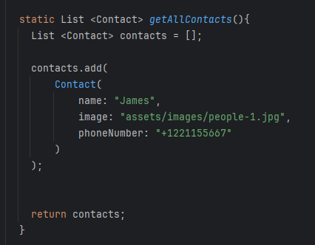
Example App (Contact List)
In the getAllContacts() function, add an Contact data object to the contacts list.
Mobile Application System Design

Slide 10
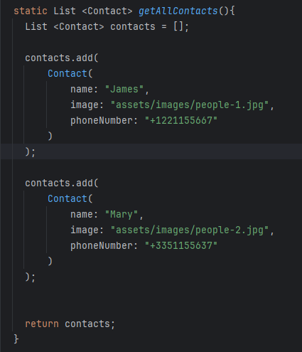
Example App (Contact List)
Add the second data object to the contact list.
Mobile Application System Design

Slide 11
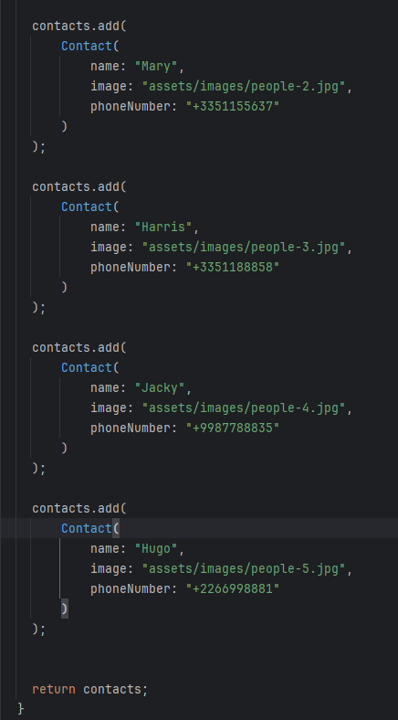
Example App (Contact List)
Add the third, fourth and fifth data to the contact list by repeating the similar steps.
Mobile Application System Design

Slide 12
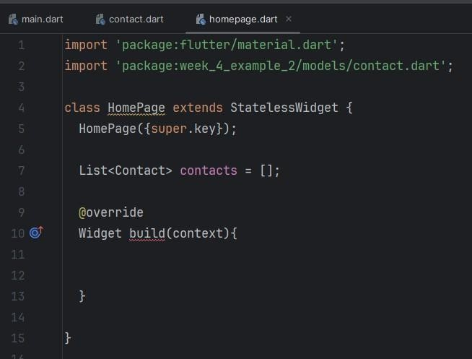
Example App (Contact List)
Create a new dart file named “homepage.dart”.
In the new dart file, create a StatelessWidget
Create a new variable named contacts to store a list of contact data.
Mobile Application System Design

Slide 13
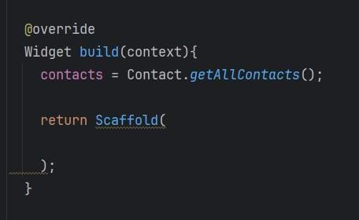
Example App (Contact List)
In the build function, invoke the getAllContacts() function to extract all the contact info and store them in the contacts variable.
Set a Scaffold layout for the
ListView.
Mobile Application System Design

Slide 14
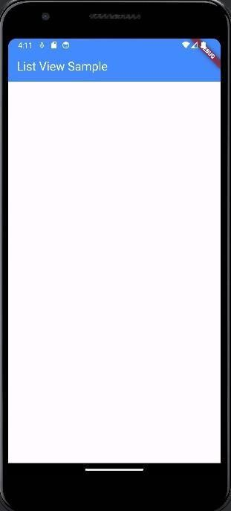
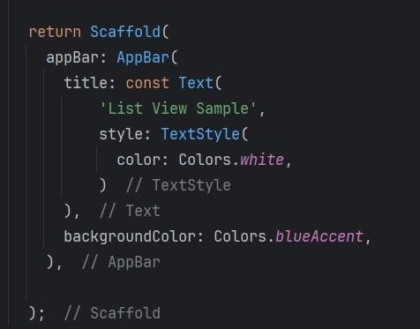
Example App (Contact List)
Add an AppBar to the Scaffold layout.
Set the background to blue accent and the text color to white.
Mobile Application System Design

Slide 15
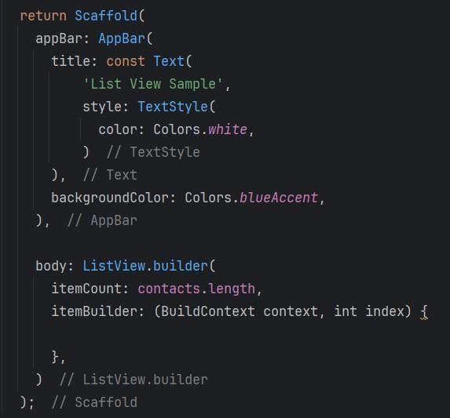
Example App (Contact List)
Set a ListView builder as the widget of the Scaffold body.
The itemCount is set to the length of the contact list.
Mobile Application System Design

Slide 16
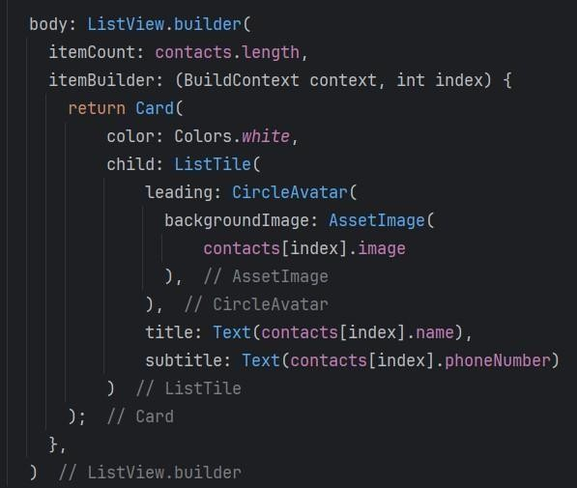
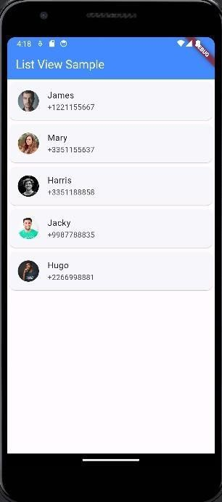
Example App (Contact List)
The itemBuilder should generate a Card Widget which consists of an avatar image, and two text widgets.
Mobile Application System Design

Slide 17
Mobile Application User Interface Operations
Content
Screens and Widgets
Working with Multiple Screens
Screen navigation with Flutter Navigator
Mobile Application System Design

Slide 18
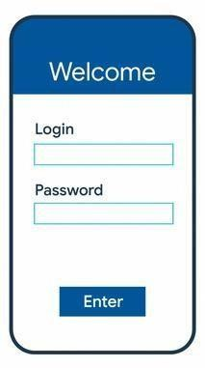
Screen
A widget is a key component of the user interface (UI) in Flutter. Widgets describe the structure and layout of the application's UI elements, such as buttons, text fields, images, containers, and more.
Widgets
A screen is a page view (e.g., a login page, a main page, etc.) consisting of multiple widgets.

Slide 19
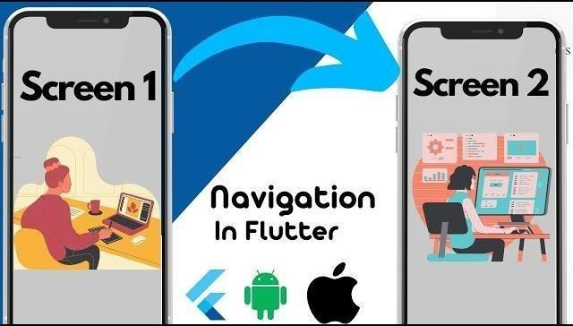
Navigation in Flutter refers to moving from one screen or page to another within your app.
It's a fundamental aspect of building mobile applications, enabling users to seamlessly explore different sections or features.

Slide 20
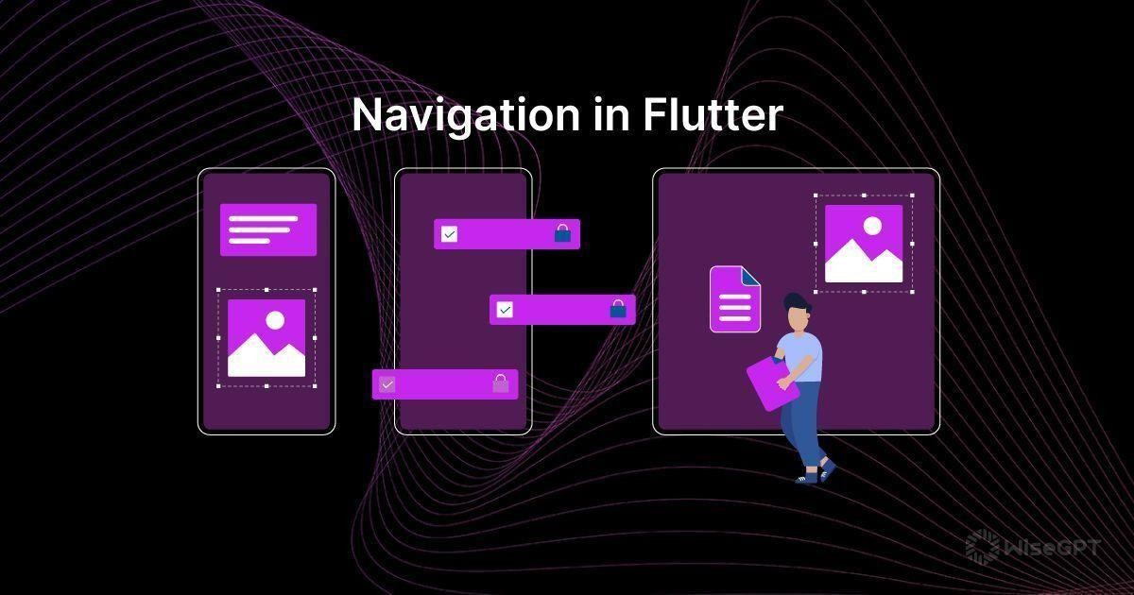
Screen Navigation in Flutter
Three main types of navigation
Stack Navigation
Tab Navigation
Drawer Navigation
Mobile Application System Design

Slide 21
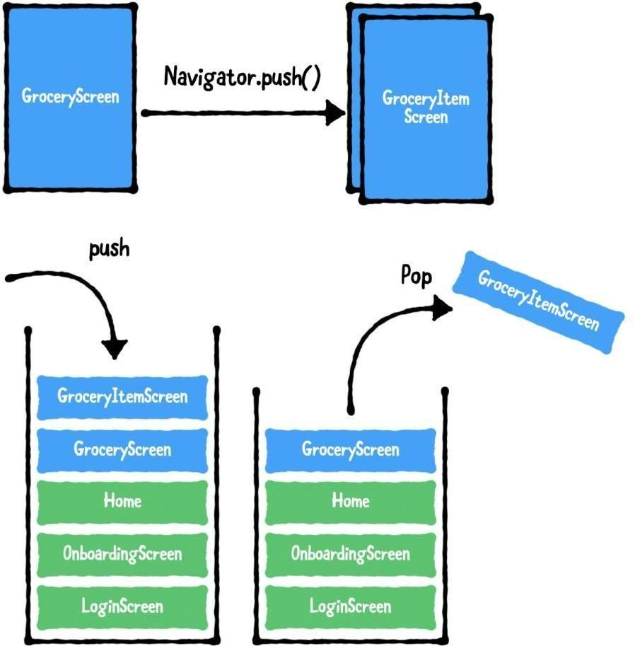
Stack Navigation
Imagine a deck of cards, where you can add or remove cards from the top of the stack. Stack Navigation in Flutter works similarly.
When you move to a new screen, the current screen is pushed onto the navigation stack, and when you return, the top screen is popped off the stack.
This navigation type is commonly used for
hierarchical and linear flows within an app.

Slide 22
CLASS ACTIVITY
(2nd Hands-On Practice)

Slide 23
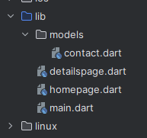
From the existing project from Example 1 app, create a new dart file named “detailspage.dart” in the lib folder.

Slide 24
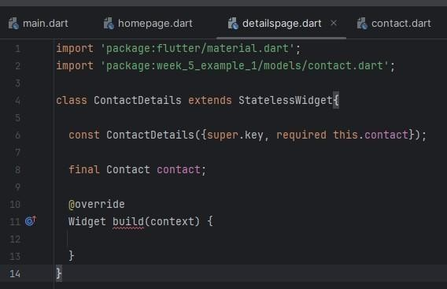
Example 2
In the detailspage.dart file, create a ContactDetails class that extends a StatelessWidget class.
The ContactDetails class should accept a parameter named “contact”
a parameter named “contact”
Mobile Application System Design

Slide 25
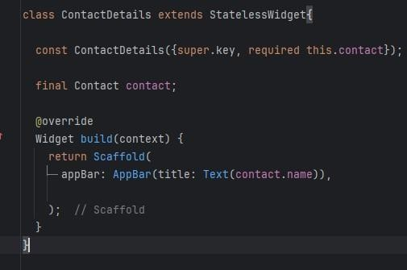
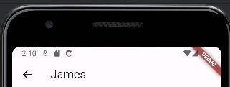
Add a Scaffold layout widget.
Set the AppBar title as the person’s name in the contact.

Slide 26
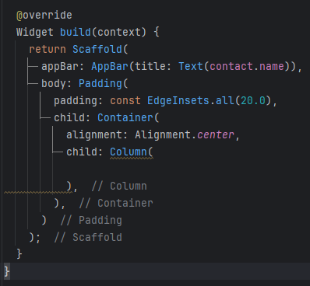
Add a Padding layout widget to wrap a Container.
In the Container, set alignment to center so that the widgets in the container will be aligned to the center.
Set a Column layout widget as the child of the Container.

Slide 27
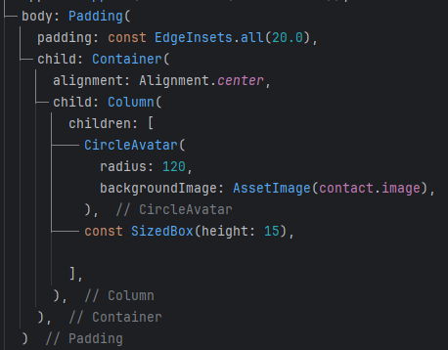
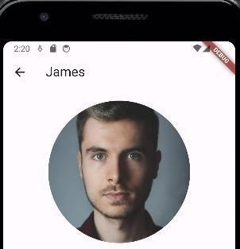
Example 2
In the Column widget, add a Circle Avatar widget as one of the children of the Column.
Create a SizedBox widget to leave 15 px vertical gap for the next widget.
Mobile Application System Design

Slide 28
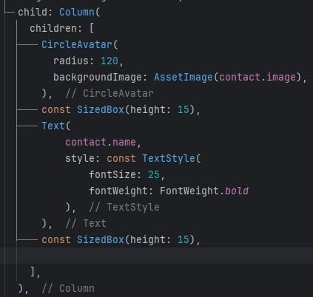
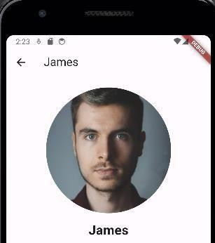
Example 2
Add a Text widget as part of the Children of the Column.
This text widget should display the contact name in bold format.
Add another SizedBox widget to leave 15 px vertical gap.
Mobile Application System Design

Slide 29
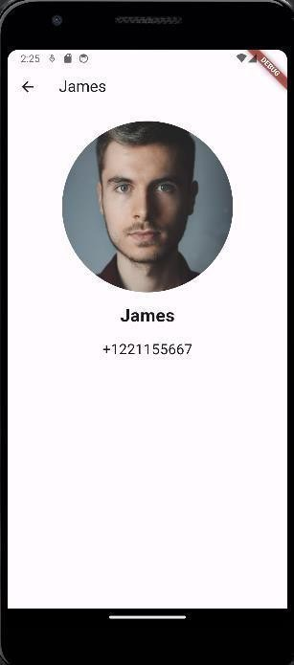
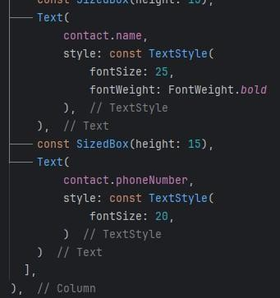
Example 2
Add another Text widget as part of the Children of the Column.
This text widget should display the contact number.
Mobile Application System Design

Slide 30
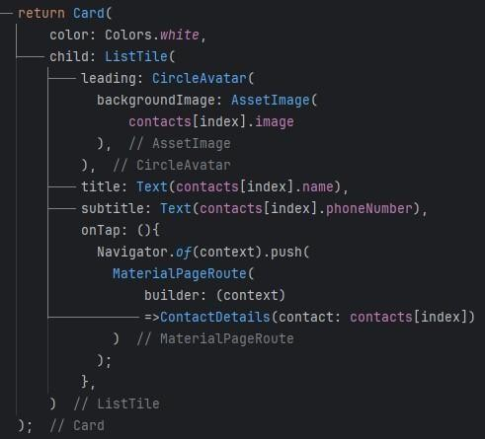
In the homepage.dart file, add an onTap property to the ListTile.
Define an anonymous function for onTap.
This function will use Navigator to route a screen to another screen when user click on one of the item in the list.

Slide 31
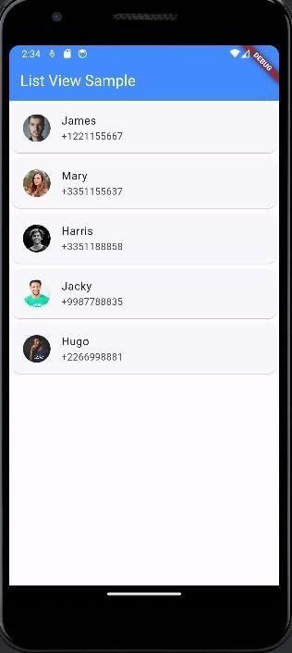
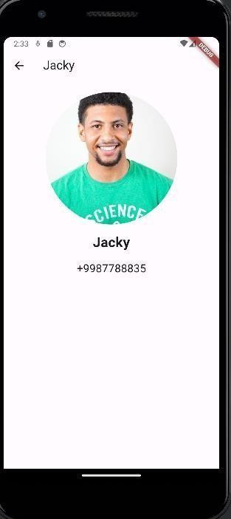
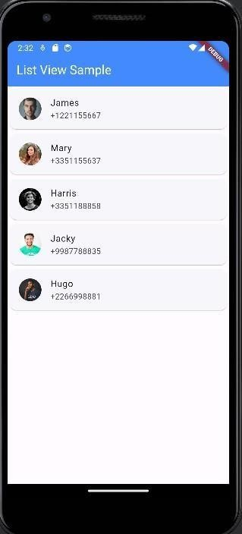
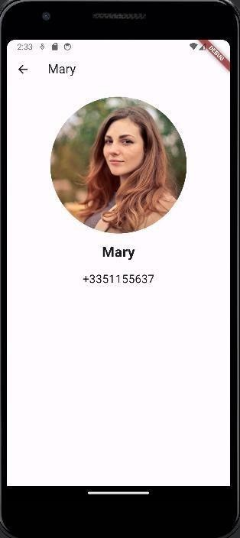
Click
Click

Slide 32
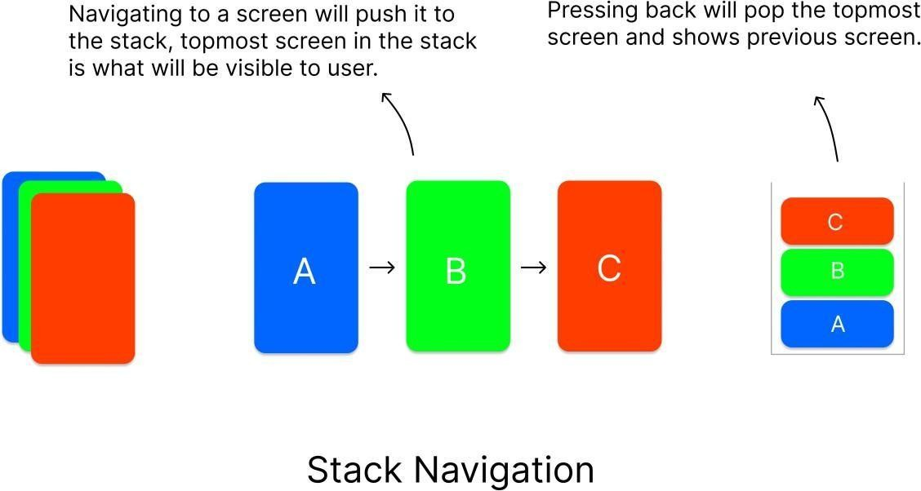
Navigator is a widget that helps us to navigate between the screens.
The navigator follows stack method when dealing with the screens.
Based on the actions made by the user, the screens are stacked one over the other and when pressed back, it goes to the most recently visited screen.

Slide 33
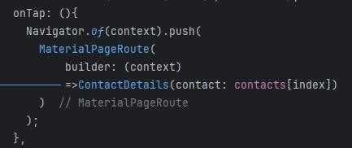
A Contact object
Flutter provides a basic routing class MaterialPageRoute and two methods Navigator.push() and Navigator.pop() that shows how to navigate between two routes.
Constructor function that build a Contact Details screen

Slide 34
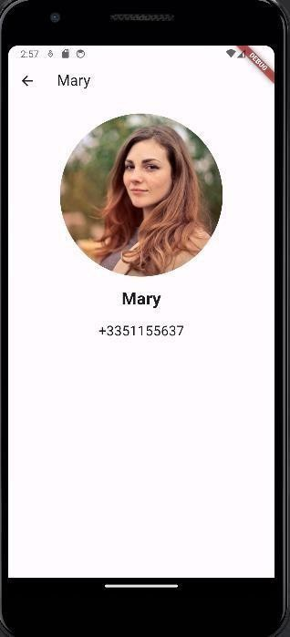
Click
Navigator will push the Contact Details on top of the stack
Navigator will automatically implement pop method to remove the Contact Details screen from the stack
Click

Slide 35
See you next class

